Slide 1
Adaptations of
William Shakespeare’s
The Tempest
24 April 2014
Joshua Wilkey, Kelli Glenn, Kevy Nelson, Sebian Mull, Jessie Shearin, Logan Costner, Meghan Suminski, Megan Elmore, and Bobbie

Slide 2
A Survey of the Adaptations
The Gentleman Poet, a novel
The Dream of Perpetual Motion, a novel
A Tempest, a play
Caliban’s Hour, a novel
Brave New World, a novel
Tempest Tost, a novel
Shakespeare Behind Bars, a film
Yellow Sky, a film
Forbidden Planet, a film

Slide 3
Printed Works
A play, and novels that range from futuristic sci-fi to a love story.

Slide 4
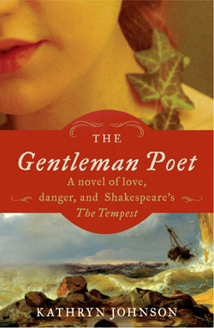
The Gentleman Poet, by Kathryn Johnson
Major Characters:
  Elizabeth “Miranda” Persons
  Thomas Powell
  William Strachey (Shakespeare)

Slide 5
The Gentleman Poet, by Kathryn Johnson
Plot Summary:
  150 passengers and crew aboard the Sea Venture, headed for Jamestown Virginia, are shipwrecked after a hurricane.

Slide 6
The Gentleman Poet, by Kathryn Johnson
Shakespeare Connections
  Shakespeare is a character in the story – the novel supposes that perhaps the Bard was shipwrecked while writing The Tempest.

Slide 7
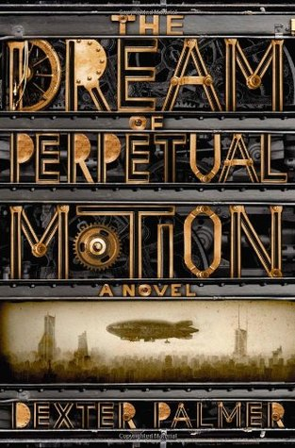
The Dream of Perpetual Motion, by Dexter Palmer
Major Characters:
  Prospero
  Miranda

Slide 8
The Dream of Perpetual Motion, by Dexter Palmer
Plot Summary:
  A young man tries to save the woman he loves from her father.

Slide 9
The Dream of Perpetual Motion, by Dexter Palmer
Shakespeare Connections
  Themes of change, love, and magic.

Slide 10

A Tempest (Play), by Aime Cesaire
Major Characters:
  Almost the same as Shakespeare’s The Tempest.

Slide 11
A Tempest (Play), by Aime Cesaire
Plot Summary:
  Also essentially the same as The Tempest.

Slide 12
A Tempest (Play), by Aime Cesaire
Shakespeare Connections
  Given the closeness of the stories, the similarities are clear.

Slide 13
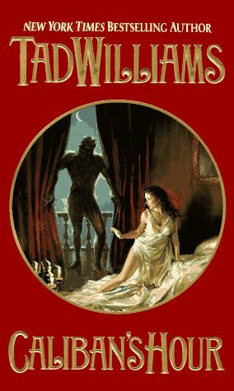
Caliban’s Hour, by Tad Williams
Primary Characters
  Miranda
  Prospero
  Caliban (Speaker)

Slide 14
Caliban’s Hour, by Tad Williams
Plot Summary:
  The story is set in Naples, twenty years after Miranda escaped the island life…

Slide 15
Caliban’s Hour, by Tad Williams
Shakespeare Connections:
  Unlike The Tempest, the audience feels for Caliban, seeing his side of everything.

Slide 16
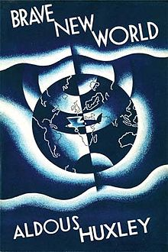
Brave New World, by Aldous Huxley
Primary characters:
  John
  Bernard Marx
  Helmholtz Watson
  Lenina Crowne

Slide 17
Brave New World, by Aldous Huxley
Plot Summary
  Set in London in the year 2540, the book explores advancements in reproductive technology and human conditioning, and the impacts of technology upon society.

Slide 18
Brave New World, by Aldous Huxley
Shakespeare Connections:
  On a basic level, the book is full of one-liners from The Tempest. Even the title comes from the play.
  John, a “savage,” explores a new kind of world in much the way that Caliban experienced a new world. There is a strong parallel between the two.

Slide 19
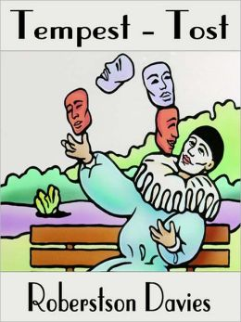
Tempest Tost, by Robertson Davies
Primary Characters:
  Solomon “Solly” Bridgetower
  Roger Tasset
  Hector Mackilwraith
  Griselda Webster
  Fredegonde “Freddy”
  Walter Vambrace
  Pearl Vambrace
  Humphrey Cobbler

Slide 20
Tempest Tost, by Robertson Davies
Plot Summary:
  In Salterton, Canada, there is a small group of people who set out to perform Shakespeare’s The Tempest…

Slide 21
Tempest Tost, by Robertson Davies
Shakespeare Connections:
  The obvious connection is the “play within a play.”
  Some of the characters are one-for-one allegorical.

Slide 22
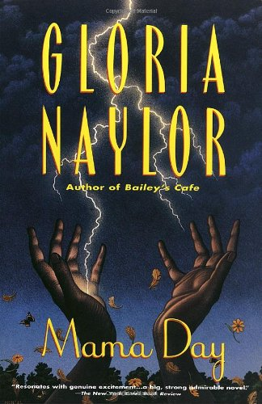
Mama Day, by Gloria Naylor
We won’t steal the thunder from Dr. Adams, since we will be discussing this novel on the final day of class!

Slide 23

Prospero’s Daughter, by Elizabeth Nunez
Primary Characters:
  Peter Gardner
  Virginia Gardner
  Carlos
  John Mumsford
  Ariana

Slide 24
Prospero’s Daughter, by Elizabeth Nunez
Plot Summary:
  On a small island called Chacachacare a man escapes with his daughter. Years later a man comes to investigate a supposed rape that has happened on the island…

Slide 25
Prospero’s Daughter, by Elizabeth Nunez
Shakespeare Connections:
  Both deal with racism and usurping power.
  Shakespeare’s Prospero unleashes the tempest on his brother, Nunez’s Prospero unleashes a metaphorical tempest on Carlos.

Slide 26
Films
A stereotypical western, and Robbie the Robot!

Slide 27

Forbidden Planet
Primary Characters:
  Spaceship Crew
  Dr. Morbius
  Altaira
  Commander Adams
  Robby the Robot

Slide 28
Forbidden Planet
Plot Summary:
  Set in the year 2020, the government sends a spaceship under the watch of Commander Adams to investigate an alien planet from which a previous mission never returned.

Slide 29
Forbidden Planet
Shakespeare Connections:
  The film is in many ways a one-to-one allegory. Dr. Morbius uses technology in much the same way Prospero uses magic.
  Power is a primary theme.

Slide 30

Yellow Sky
Primary Characters:
  James “Stretch” Dawson
  Constance Mae
  Dude
  Bull Run
  Lengthy
  Half Pint
  Grandpa
  Walrus

Slide 31
Yellow Sky
Plot Summary:
  A group of bank robbers flee into the desert and happen upon an abandoned mining town where the only two residents are a man and his granddaughter.

Slide 32
Yellow Sky
Shakespeare Connections:
  While there’s no shipwreck, the gang of bank robbers ends up essentially “deserted” in a ghost town occupied only by Constance Mae and her grandpa. Eventually, three of the robbers return the money they stole and ride off into the sunset with the girl and her grandpa. Redemption is the end theme.

Slide 33

Shakespeare Behind Bars
The film is a documentary about a group of men in prison who participate in putting on Shakespeare’s The Tempest. The director chose the play because it is about forgiveness and redemption – themes to which the prisoners can relate.

Slide 34
Over-arching Themes of Adaptations
Technology, and Magic via Technology
The mystery of a deserted or distant setting
The dynamics of love
Redemption
Civilization versus “savages”

