Slide 1
King Lear
James Charles Holdsworth
Bev Tan
Sarah Solomon

Slide 2
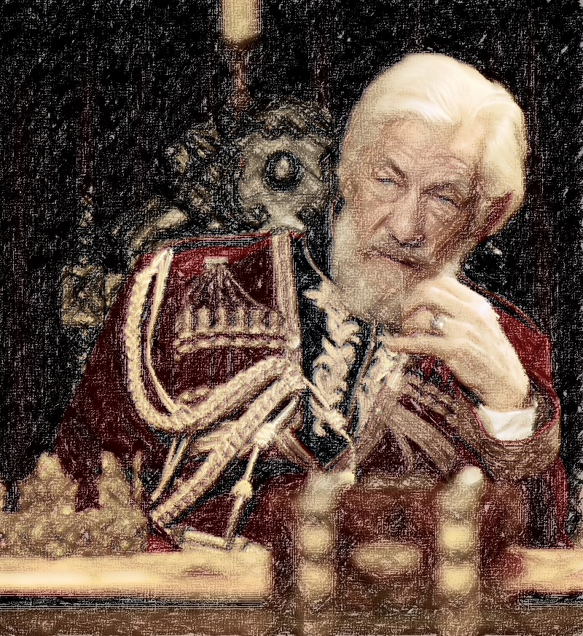
King Lear
King Lear was the king of Britain
He divided his kingdom amongst three daughters
How to decide divisions?
Who loves him most
Goneril and Regan flatter
Cordelia remains silent
Lear Disowns Cordelia

Slide 3
King Lear
Noblemen Glouster’s Illegitimate Son Edmund Convinces Father Edgar is evil
Innocent edgar flees
Edgar helps lear after hearing what happened
Edgar is viewed as a traitor

Slide 4
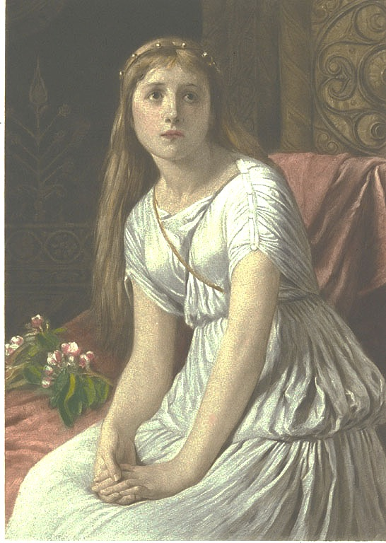
King Lear
In Dover, French Army Invades
Led by Cordelia to save Lear
Edmund is romantic with Goneril and Regan
Gloucester fails committing suicide
Edgar tricked him into believing he jumped off a cliff

Slide 5
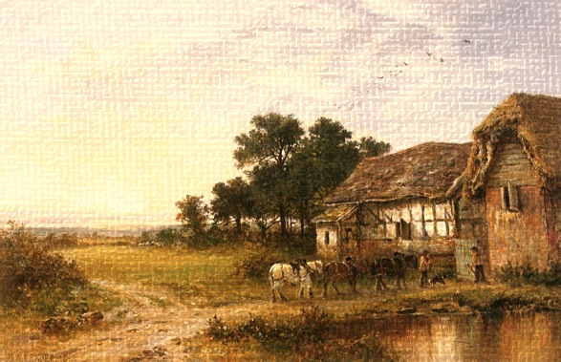
King Lear
English, led by Edmund, capture Lear and Cordelia
In a duel, Edgar kills Edmund
Glouster dies, Goneril poisons Regan and commits suicide
Edmund is executed in prison, lear dies in grief

Slide 6
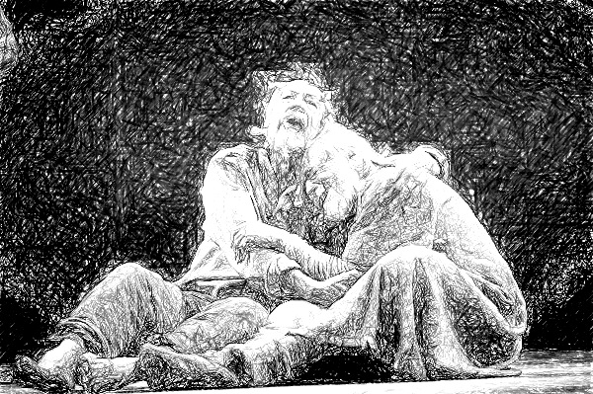
King Lear
Albany, Edgar, and Kent
Are left to run the
Country

Slide 7
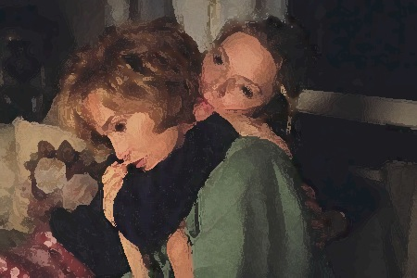
A Thousand Acres
Larry Cook – Prosperous Farmer
Like lear, decides to retire
Siblings are named directly after, and even have same letter names
Ginny, Rose, Caroline
Caroline leaves for a law career in Des Moines

Slide 8
A Thousand Acres
Larry becomes senile and fights with Rose and ginny
Rose Comes out that Larry sexually abused her as a child, distancing Ginny
Both fall for a neighbor, jess
Larry sues Rose and Ginny, asking for Caroline’s help
Lawsuits permanently divide family

Slide 9
A Thousand Acres
Rose and Ginny suffer alone
Larry dies of a heart attack
Land is divided amongst the three girls

Slide 10
A Thousand Acres
Lear and larry are very similar
Both curse daughters for sterility
Though main difference is that Larry is actually evil while lear is distraught.

Slide 11
Broken Lance
Matt Deveraux – ranch owner
Irish settlement
Children are males
Joe, a mix of irish and native american is badly picked on
The other boys rustle cattle and get two mexicans killed
Matt shoots them when they are caught, with two other indians.

Slide 12
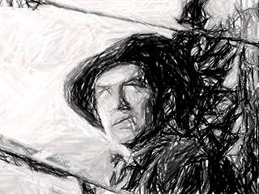
Broken Lance
40 Cattle Die
Matt discovers copper mine, which he chooses to raid
Despite the fact that the mine was on his land, he had no rights to it
Joe claims responsibility for this and spends several years in jail

Slide 13
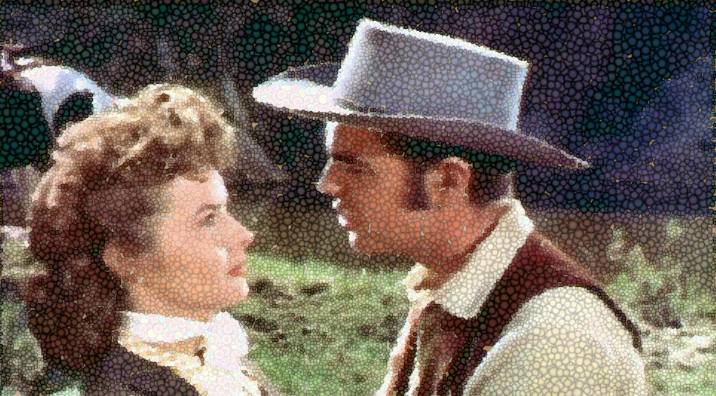
Broken Lance
After prison, joe discovers his brothers caused their father to have a stroke, ending in his death
He seeks revenge
This iteration is very loosely tied to King lear:
Three male siblings
Siblings essentially kill father
Father favored one child

Slide 14
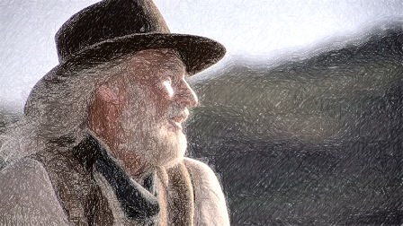
King of Texas: Character Comparisons
Lear: John Lear
Goneril: Mrs. Susannah Lear Tumlinson
Raegan: Mrs. Rebecca lear Highsmith
Cordelia: Claudia

Slide 15
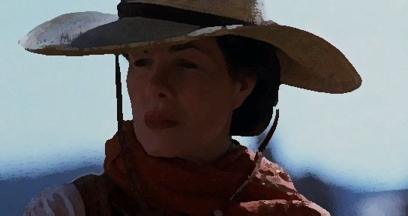
King of Texas
Directly paraphrased from king lear, john lear chooses to leave his land to whichever daughter shows the much love
Not surprisingly, claudia does not want to pander to her father and participate
When john’s land is threatened, he realizes that claudia is the only one capable.

Slide 16
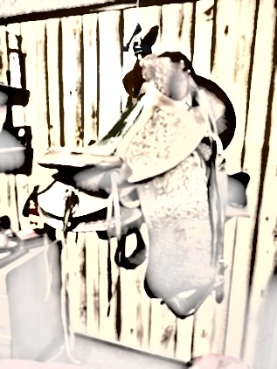
Broken Lance
Order dissolves to chaos quickly
Other siblings desire more land, and make this know
This version of Lear is different in that it is the siblings that start the invasion, while lear learns the reality of war and how he came to power, and feels shame.
Manifest destiny was insane

Slide 17
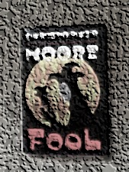
Fool
An adaptation similar in concept to Rozencrantz and Guildernson are dead
Lighthearted in comparison to King Lear, ends happily
Tells the story from a fool of the court in Britain
The fool works with a girl named pocket to manipulate the entire situation, motivated by his desire to prevent lear from marrying off cordelia

Slide 18
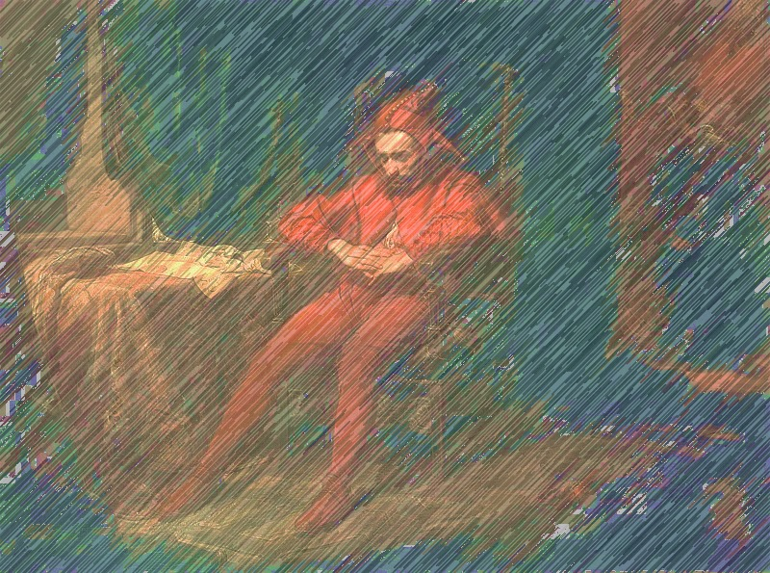
Fool
The prince of france marries cordelia anyways
Angry with lear because of his treatment of Cordelia, pocket, advised by a ghost, starts his own vendetta.
The goal was to strip lear of his remaining power (including his knights) and manipulate the situation to cause the older sisters to go to war

Slide 19
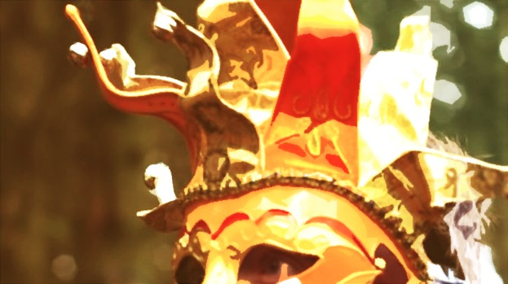
Fool
Lear realizes the error going on.
Pocket tries to make both believe they are in an affair with Edmund
The intent of civil war though is failed
Cordelia invades and takes over all of it instead from france
Sisters attempt an alliance against cordelia, but poison eachother in jealousy instead
Lear dies, cordelia gains power. Pocket, who has been told he is the son of lear’s brother, is crowned king after marriage

Slide 20
Bibliography
Broken Lance. Dir. Edward Dmytrk. By Richard Murphy. Perf. Spencer Tracy, Robert Wagner. 20th Century Fox, 1954.
"Broken Lance." IMDB. N.p., n.d. Web. <http://www.imdb.com/title/tt0282659/>.
Griggs, Yvonne. Shakespeare's King Lear: A Close Study of the Relationship between Text and Film. London: Methuen Drama, 2010. Print.
King of Texas. By Stephen Harrigan and William Shakespeare. Dir. Uli Edel. Perf. Patrick Stewart. Flying Freehold Productions, 2002.

Slide 21
Bibliography
Micheal. "King of Texas (2002)." Weblog post. Correlated Content. N.p., 27 May 2011. Web. <http://correlatedcontents.com/?p=1028>.
Moore, Christopher. Fool. New York: William Morrow, 2009. Print.
My Kingdom. Dir. Don Boyd. Perf. Richard Harris, Don Bell, Lynn Redgave. Close Grip Films Ltd., 2001.
Shakespeare, William. The Tragedy of King Lear. Ed. Jay L. Halio. Cambridge: Cambridge UP, 1992. Print.
A Thousand Acres. Dir. Jocelyn Moorhouse. Perf. Michelle Pfeiffer, Jessica Lange. Touchstone Pictures, 1997. DVD.

