Slide 1
Early Modern Theater to 1640
An Overview by Mary Adams

Slide 2
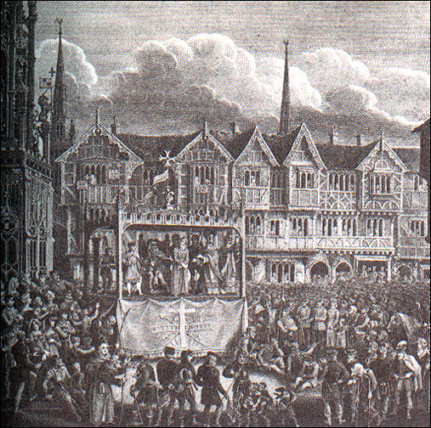
Early theater
In medieval times, trade guilds performed religious plays on religious holy days. They often competed for prizes.

Slide 3
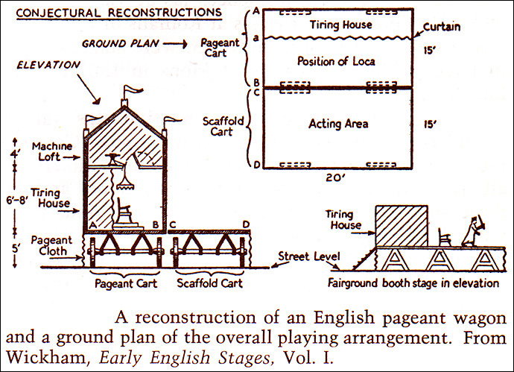
Pageant wagons
Blueprints of pageant wagons, and a simulation of their movement through the streets here: http://jerz.setonhill.edu/resources/PSim/applet/index.html Three kinds of religious plays:
Mystery plays – about Christ or from the Old Testament – usually done in cycles (Second Shepherds’ Play is one of these).
Miracle plays – lives of saints, historical and legendary
Morality plays – didactic allegories, often of common man’s struggle for salvation (Everyman – only his good deeds accompany him in death).
Secular (non-religious) plays, first from Latin farces and then from Italian sources, were staged at festivals. Professional actors were attached to noble houses.

Slide 4
Pageant wagon re-enactment
The first professional players not attached to professional houses probably looked like this. They got their material from classical sources and were influenced, in particular, by the commedia del arte in Italy. These farces had stock characters such as the Pantalone (old cuckold with a young wife).

Slide 5
Commedia del arte
Commedia del arte was characterized by improvised text based on plot outlines. It featured stock characters, some of whom wore distinctive masks. Its actors were acrobats, dancers, musicians, orators, quick wits, and improvisers. Most Commedia troupes performed outdoors in city and town piazzas on stages they brought with them in horse-drawn carts, along with their equipment, props, costumes, curtains, and ladders. Some of the better Commedia troupes performed in Renaissance theatres such as Palladio's theatre in Vicenza or the Petit Bourbon in France.

Slide 6
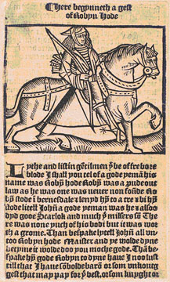
Henry VIII
When Henry VIII broke with the church, he used community theater as propaganda against “the abomination and wickedness of the Bishop of Rome, monks, friars, nuns, and such like.” He was advised to use such plays to replace popular drama such as “Robin Hood” and “Friar Tuck,” “wherein besides the lewdness and ribaldry…disobedience to your officers also is taught.” Laws were passed to censor and control plays as early as 1545.
Robin Hood manuscript from 1510-15.

Slide 7
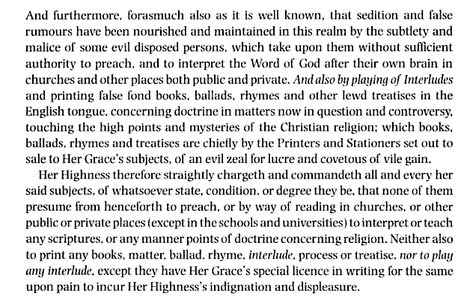
Bloody Mary 1553-1558
Proclamation against religion in the Tudor Theatre: 1553
Religious strife abounded in the Tudor period after Henry VIII declared his independence from Rome. His daughter, Mary, tried to bring the Catholic religion back, but after her death Elizabeth I made Protestantism the law of the land. (She had to, because the Catholic church did not recognize the legitimacy of her birth.) Catholic opponents remained a threat to Elizabeth’s power. Elizabeth’s successor, James VI & I, had to agree to practice the Protestant religion.

Slide 8
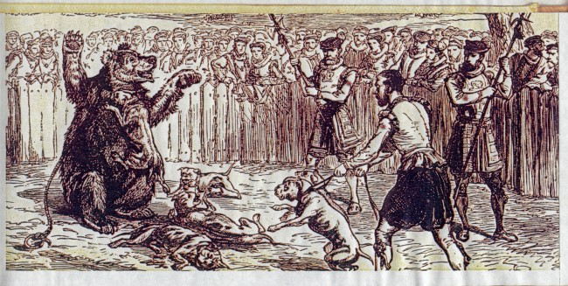
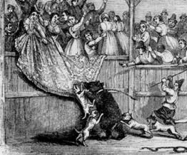
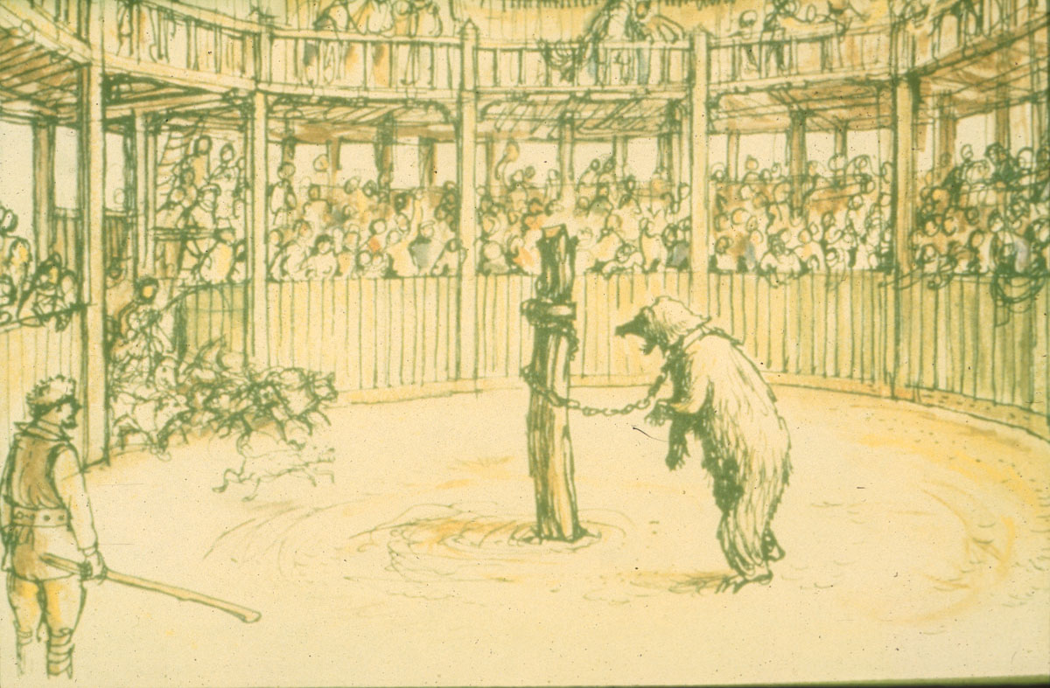
Professional Acting Companies 1559
In 1559, four years before Shakespeare was born, the first licensed companies were created: the Earl of Worcester's Men; the Earl of Warwick's Men; and Lord Strange's Men. Shakespeare probably acted in Lord Strange’s Men and wrote plays for them.
Licensing meant that the content of plays, which escaped censors by not printing their work, could be more tightly controlled.
By the 1590’s, all play content was controlled by the Queen’s censor, the Master of the Revels. Only young boys’ companies had few restrictions.
The first professional companies played in Inns and Bear-baiting arenas. London censorship soon drove all companies south of town, where they shared their marshy spaces with prostitutes and thieves.

Slide 9
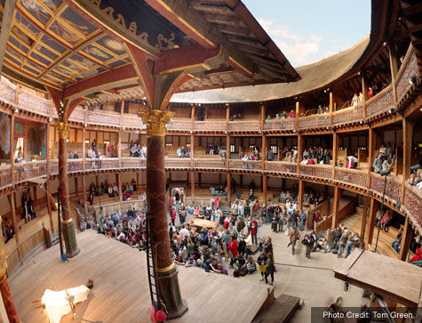
First professional Theater 1576
In 1576 James Burbage built the first professional theater in the northern London suburb of Shoreditch. He had a 21- year lease. In 1587 The Rose, the second professional theater, was built by Philip Henslowe. By the mid 1590s, Shakespeare’s company, The Admiral’s Men, had to compete with several other professional companies, many with their own Theaters.
The Theater probably looked something like this. In 1598 Shakespeare’s company lost their lease on the property, so they took the theater down late one night, stored it for the winter, and rebuilt it in early 1599 as The Globe, which had a flammable thatched roof.

Slide 10
From “Shakespeare in Love” copyright Miramax Films / Universal Pictures

Slide 11
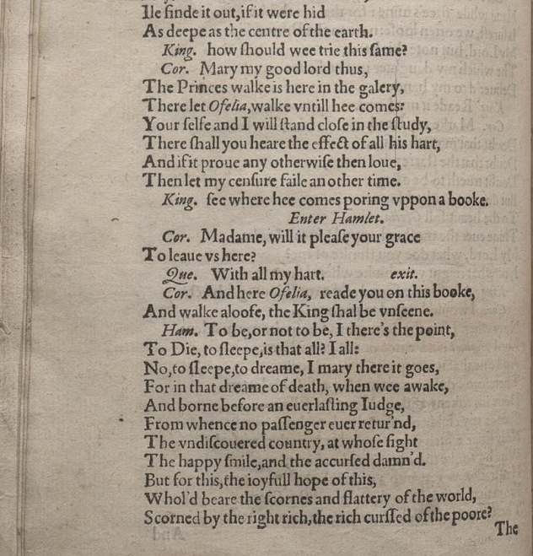
Conventions of Elizabethan Theater
To avoid political problems and because printers, not authors, held copyrights, Shakespeare’s company seldom printed their plays unless they needed to raise cash, but texts of plays were often stolen, resulting in “short” or “bad” quartos. Other early texts exist in the form of prompt books. We know many versions of some plays existed, perhaps because they were shortened for court or road performances when theaters were closed because of plague.
First quarto of Hamlet, perhaps reconstructed by a fired actor.

Slide 12
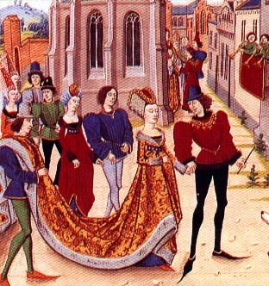
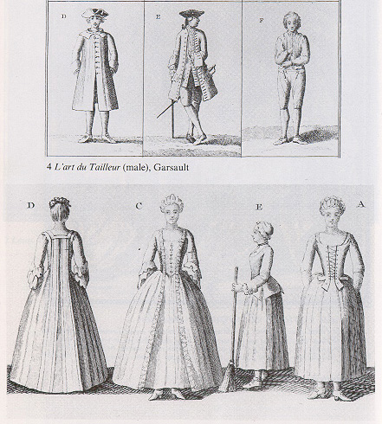
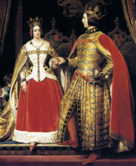
Conventions, cont’d
Elizabethan acting companies used little scenery but spent a good deal on cast-off aristocratic costumes (these would have been used even for Roman plays). Early modern “sumptuary laws” dictated that no one could cross-dress or dress above their station. Only aristocrats could wear swords, but actors in Shakespeare were frequently arrested for sword fighting, wearing aristocratic dress, and brawling in the streets.
Sumptuary laws dictated that the poor wear hats on holidays. They outlined who could wear what fabric and when; how much material a woman could have in her ruff or her train, and how long a man’s sword could be. They even regulated the waistlines of the queen’s ladies in waiting (14 inches).

Slide 13
Conventions cont’d
All parts in Shakespeare’s company were played by boys, and to safeguard the script, no one saw any part but his own. Like many of his contemporaries, particularly the very popular Christopher Marlowe, Shakespeare used a combination of rhymed verse, blank iambic verse, & prose. He borrowed his plots from many sources and rarely created his own. His early history plays & comedies used stock characters like the Vice and bawdy jigging comic. Richard Burbage played the leads. Shakespeare probably played old man parts.
In this scene, Richard winks suggestively at his audience like a stock
Medieval Vice figure. Copyright 1995 Richard III Limited. MGM-UA.

Slide 14
Conventions, cont’d
Shakespeare’s middle comedies used stock plots, too, but by then Shakespeare had learned to complicate his stereotypes and make even his English kings complex and imperfect. Shakespeare was a master at playing to all audiences. Though he was interrogated about a famous production of Richard II, which contained a highly dangerous scene where the monarch is deposed onstage, Shakespeare was one of the few playwrights of his age to avoid imprisonment, assassination, or execution.

Slide 15
Conventions, cont’d
Most of Shakespeare’s plays would have taken 2-3 hours to perform. They were performed in the afternoon on sunny Sundays, generally in late spring through early autumn. Playgoers were young and unmarried, since the average poor Londoner died before the age of 30. Prostitutes worked the room. In war time, young men in the audience could be forcibly conscripted to fight in Ireland.
In 1603, Shakespeare’s company became the King’s men, performing mainly at court and traveling with the new King James I. Though he still had many great tragedies and romances ahead, Shakespeare wrote few plays after Hamlet that had the popular appeal of his early comedies and histories.
Hamlet, copyright 1996 Castle Rock Entertainment.

Slide 16
Jacobean Drama
Late in Shakespeare’s career, The King’s Men got permission to perform at an indoor theater called Blackfriars. Shakespeare’s fellow actor Ben Jonson had perfected the court masque, a hugely expensive production in which aristocrats could play minor parts. Soon all the plays had to have masques in them. Old plays were revised for Blackfriars. Act divisions were added to plays so aristocrats could dance between scenes, and profanity was cut. Collaborators even added a witch’s masque to Macbeth. New plays like The Tempest were written for the wealthier Blackfriars audience. They doubled as court entertainments for the weddings of visiting dignitaries. These plays featured movable sets, elaborate 3-d sets and props, masqued dances, and flying goddesses.

Slide 17
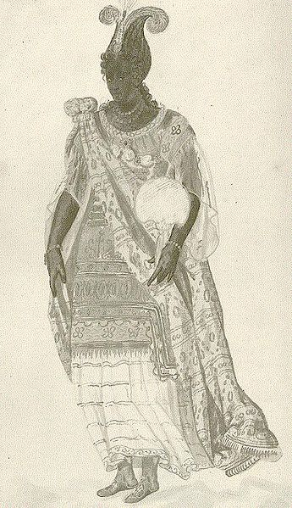
Jonson’s Masque of Blackness
Inigo Jones designed a mobile 40-foot stage for this masque. It contained machines that produced stage effects and the technicians who operated them. It opened with a tempestuous seascape, simulated by flowing and billowing cloths.
The opening stormy sea was populated with six blue-haired merman-like tritons. The gods Oceanus (white) and Niger (black) entered, mounted upon giant seahorses.
The twelve daughters of Niger, played by the Queen and her ladies in waiting, were dressed in silver and azure, with pearls and feathers in their hair. Torchbearers were dyed blue.
The ladies rode in a great hollow seashell, accompanied by six large sea monsters carrying more torchbearers.
The masque was composed for Anne of Denmark, the queen consort of King James I, who wished the masquers to be disguised as Africans. Anne was one of the performers in the masque along with her court ladies, and appeared in blackface makeup. The plot of the masque follows the ladies arriving at the English Court to be "cleansed" of their blackness by King James. In Shakespeare’s The Tempest, court ladies probably performed in the wedding masque. Other masques featured cannibals, witches, & Native Americans.

Slide 18
End of an era
Jacobean Dramatists
Thomas Dekker, author of Westward Ho, The Honest Whore, Satiro-Max, The Witch of Edmonton, and Bloody Banquet
Beaumont and Fletcher, authors of The Woman Hater, Knight of the Burning Pestle, Philaster, Cupid’s Revenge, Rule a Wife and Have a Wife, and The Martial Maid
John Webster, author of The White devil, The duchess of Malfi, and A Cure for a Cuckold
Thomas Middleton, author of A Chaste Maid in Cheapside, The Changeling, and The Phoenix
John Ford, author of ‘Tis a Pity She’s a Whore, The Broken Heart, and The Lady’s Trial
Thomas Heywood, author of The Woman Killed with Kindness, A Maidenhead Well Lost, and The Life of Merlin
Ben Jonson, author of Every Man Out of His Humour, Volpone, Poetaster, The Alchemist, The Irish Masque, and The Masque of Blackness
Shakespeare’s Globe burned down in 1613 during a production of Henry VIII (the play called for a real canon to be shot off). Shakespeare’s own career was ending, and most of his latest plays were collaborations with Middleton, Beaumont, and Fletcher. The great age of playwriting continued for many years, though we remember few of those plays today. Shakespeare died in 1616 at the age of 52. His friends produced a folio of his plays in 1623.

Slide 19
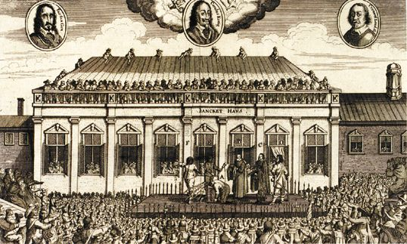
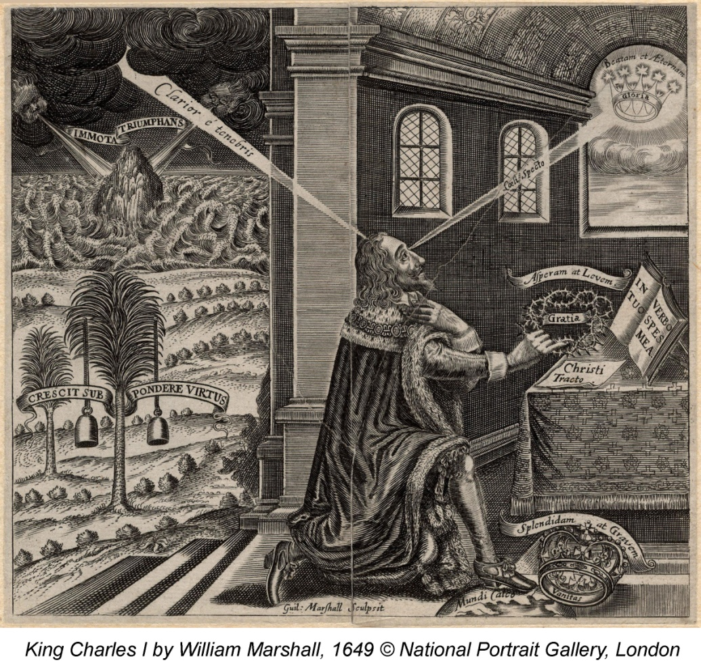
Revolution!
In the reign of King Charles I, the Puritans, who had long opposed theater and all it stood for, took over the government and executed the monarch. Parliament ordered all theaters closed in 1642. When some theaters staged illicit productions in protest, in 1648 The Puritans order all playhouses demolished, all actors whipped, and theatre-goers fined five shillings. No plays would be produced in England until the Restoration of 1660. Even Milton’s “Adam UnParadis’d” had to be recast as an epic poem.
Above, Charles I executed. Below, Charles exchanges the cares of this world for an eternal crown.

Slide 20
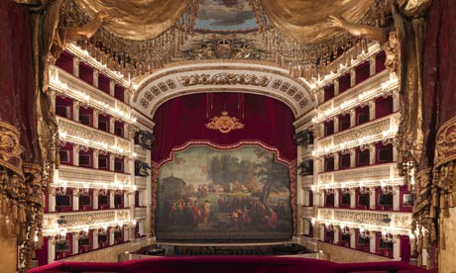
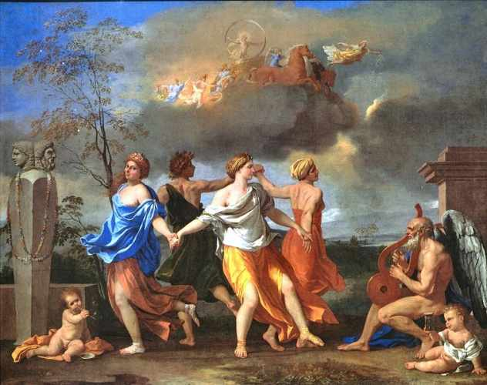
Opera
In 1660, the Theaters reopened. European opera was the rage, and women actors frequently doubled as the mistresses of aristocrats. John Gay’s Beggar’s Opera would assault the political and cultural scene with an opera whose working class characters sing drinking songs instead of arias and argue about the ending of the play itself. But that’s a story for another day.

