Slide 1
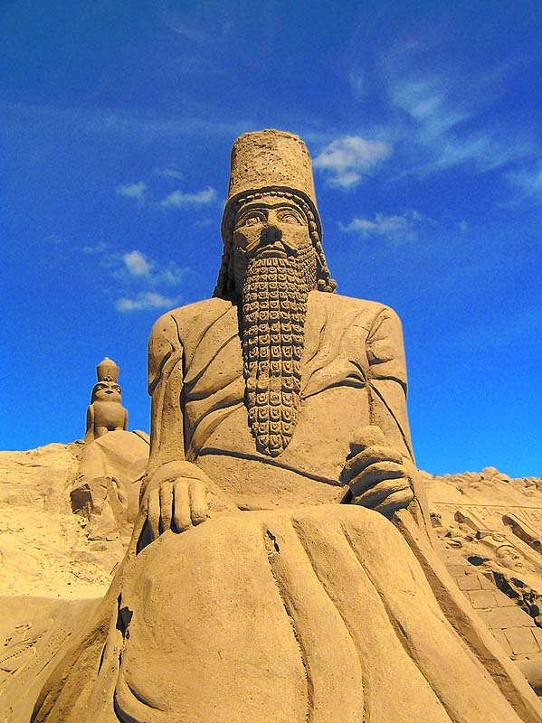
586 BCE and After:
The World that Created the Bible

Slide 2
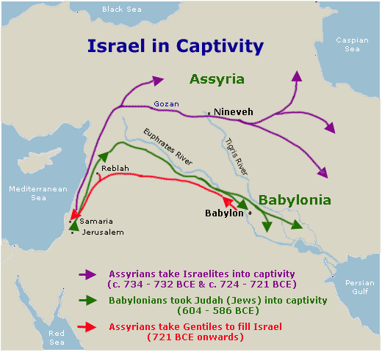
What happened in 586 BCE?
Nebuchadnezzar of Babylon completed the conquest of Israel by sacking Judah, the southern half
Previously, Assyria had conquered the northern half (Israel or Ephraim) and gentiles had colonized it from 721 onwards. Judah had become a vassal state.
All priests, prophets, scribes, and members of the royal family were exiled throughout the Babylonian empire (Babylon, Egypt, Persia, Africa). This dispersion is called the Diaspora.
Farmers & workers remain as slaves. The multiple religions they practice mingled with those of the occupying gentiles. They are an amalgam of several forms of Judaism and paganism.
This map shows the path of the Assyrian and Babylonian conquests of Israel/Judah.

Slide 3
Terms to know
Israel
Israel is the name of the county of 12 tribes from which the bible came, but also, confusingly, the name of the northern 10 tribes of the country. The bible says the north and south split during the time of Solomon, 10th-9th century BCE, but in fact they were probably never one kingdom. In fact, before its fall, Israel was probably the more powerful kingdom. Israel’s Kings Omri and Ahab, demonized in the bible, were powerful kings with international allies.
Judah
Judah is the name of the country of the southern two tribes of Israel. After the north fell to the Assyrians, they rose from a vassal state to become a kingdom. Migrating refugees from the north brought some traditions with them. Much of the bible is told from the Judahite point of view, and they probably rewrote history to cast Israel as an offshoot of a once-united kingdom.
Diaspora
After the exile, Jews lived in Judah (now called Judea or Palestine) but also all over the Babylonian empire (and later, the Greek and Roman empires). Some traditions diverged; Jewish communities outside Judea had different traditions, retained goddess worship, gave their God a different name, and didn’t follow the same rules as those in Judea. The four New Testament gospels were written for four very different Jewish (or Gentile) audiences.

Slide 4
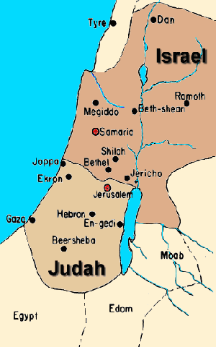
What was Israel before?
The Israelites were a nomadic people who settled in the Canaanite highlands after a series of invasions weakened both Egypt, which had controlled Canaan, and Mesopotamia. Because the north terrain was better suited to creating wine and oil, this area became wealthy and developed powerful city states after Egyptian control waned, while the south rose only after the north fell.
While both kingdoms had fallen to the Assyrians in 721 BCE, the south, where the Jerusalem temple housed many important archives, survived longer.
Most of the biblical story is told by survivors of the Southern Kingdom. “Jew” and “Judaism” and “Judea” are named for the southern Kingdom.

Slide 5
The First Biblical Book (or scroll)?
In Judah, literacy arose in the late 8th and 7th century BCE. King Josiah (649-609 BCE), a southern king, “found” the book of Deuteronomy, which he attributed to a legendary forefather named Moses. Josiah used it as the basis of reforms that he hoped would unite the north and south.
Some believe the first versions of Genesis and Exodus, which contain stories of a shared past, were begun at this time.
Josiah’s texts and laws suggested that political success and unity would come if his people set aside their beliefs in any god except Yahweh (a southern deity), centralized worship, and separated themselves culturally from surrounding peoples.
Josiah’s reforms were cut off when he was killed in Egypt in 609 BCE. But future generations would build a new world around his ideas.

Slide 6
Deuteronomy and the Prophecies
The next scrolls were compilations of prophecies that tried to explain 7th and 6th c. events and invasions as punishments for disobeying Deuteronomy’s rules (care for the poor, centralized worship, monotheism, and cultural separation from surrounding peoples)
By the time the rest of the Torah (Genesis, Exodus, Numbers, and Leviticus) was set down during the exile, all history was interpreted using the rules and themes articulated in Deuteronomy. By then, this seventh-century book was believed to contain Moses’ original instruction from God.

Slide 7
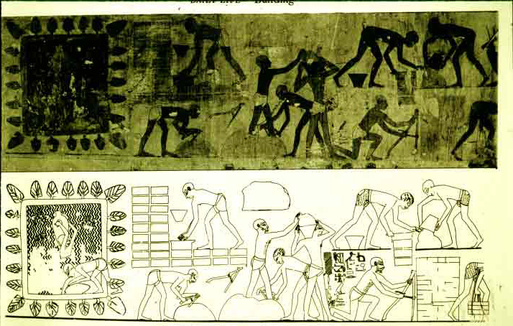
And before that?
Pre-9th century, scholars believe Israel had a provincial organization. The story of Jacob’s 12 sons is an etiological tale explaining how the 12 tribes or provinces got their names, but they were actually administrative provinces ruled by Egypt.
At one point, Canaan, a “land-bridge” between Egypt and Mesopotamia, was occupied by the Egyptians (New Kingdom 1500-1000 BCE). The breakup of this kingdom allowed for small states like Israel to emerge (first reference in 1200s); the infighting that ensued over fertile lowlands characterized early biblical history (Joshua-Kings).
Before the Egyptian occupation, these Semitics or “Asiatics,” according to the Egyptians, probably migrated all over Mesopotamia and into Egypt because of famine or conquest. Egypt, in particular, was a refuge for nomadic peoples because of luxury goods, water, religious freedom, and military protection.
This photo of an
Egyptian Wall paint-
ing shows Asiatic
workers making
bricks in Egypt in the
15th c. BCE.

Slide 8
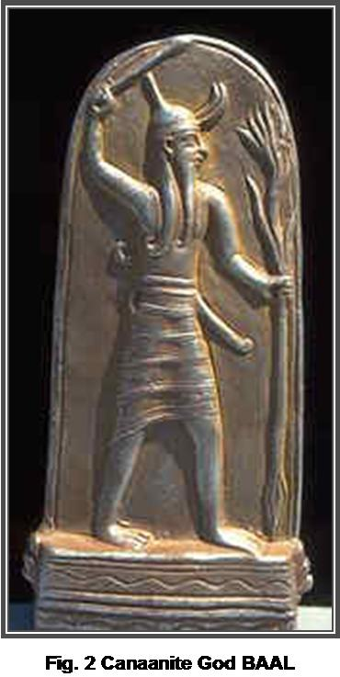
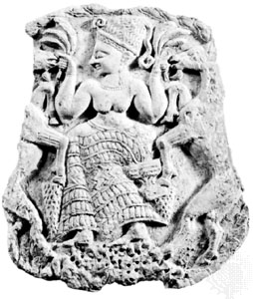
What did the Israelites/Canaanites worship?
They worshipped various gods including El, his wife Asherah, grain god Dagon, a sea god Yam and his serpent ally Lotan, a huntress Anath, a love goddess Quadeshtu, and the storm god Baal Hadad, who superseded El in the Canaanite pantheon.
A picture of Asherah, who was worshipped in hill shrines through poles and teraphim. In the King James bible, her name is translated as grove; in others, sacred pole. Compare the Good News translation of Deuteronomy 16:21: "When you make an altar for the Lord your God, do not put beside it a wooden symbol of the goddess Asherah” to the King James: “Thou shalt not plant thee a grove of any trees near unto the altar of the LORD thy God, which thou shalt make thee.”
A picture of Baal, Canaanite god of Thunder, who became a chief rival of Yahweh after King Josiah began his project to unify north and southern kingdoms under a single god.

Slide 9
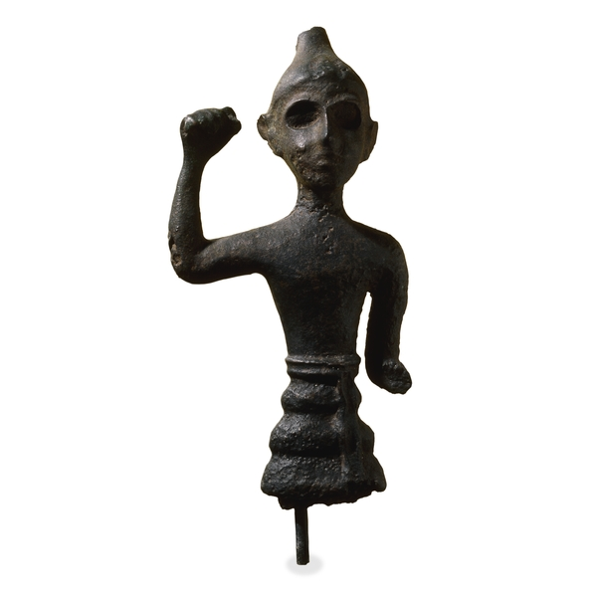
El = Yahweh?
According to the Canaanite myths, El’s marriage to Beirut (City) produced Heaven and Earth.
In the bible, when you see “God,” it is a translation of one of many versions of El (Elohim=sons of god, El Shaddai (God almighty), El Roi (God of seeing), El Elyon (God of the mountains). When you see “LORD,” it is a translation of YHWH, probably pronounced “Yahweh,” which means something like “I am” or “I will be.”
Though these names are often used interchangeably, some think they were originally two different gods, one Kenite (or “Cainite”) and one Canaanite. These gods merged in the story of Exodus, when God speaks to Moses and tells him that his name is Yahweh and that he is the God (El) of Abraham, Isaac, and Jacob. Some scholars think King Josiah revised the tale to unite the two traditions.
Before this moment, some biblical authors only call the deity “El” or God, and some call him “Yahweh.” A divergent “El” called Baal (Lord) became an enemy god.
This may be a picture of El, the Canaanite sky god, consort to Asherah.

Slide 10
Terms to know
El or God
“God” in our English bibles is a translation of El or other local variations of El: El Shaddai (God almighty), Elohim (sons of God), El Elyon (God of the mountain), El Roi (God of seeing or God who sees), etc. El was the Canaanite God’s name, but it was also a generic term for deity. Some early biblical writers use his name exclusively when discussing the deity’s activity before Moses.
Yahweh or
Lord
This name, written as the Tetragrammaton YHWH and once mispronounced Jehovah, is the name God reveals to Moses. Though redactors (editors) of the bible merged Yahweh and El, some scholars think they were once separate gods. Yahweh is translated as “Lord” in our English bibles.
Baal
Baal (Bel), or “Lord” a variant version of El (his son in some traditions),
gained prominence in the north. Josiah worked to eradicate Baal and
Asherah, El’s consort. Baal, El, and Yahweh were all represented by a bull.
Redactor
Scholars think redactors (or editors) merged multiple biblical stories or pieces of stories to form the Torah (first five books of bible), which in 586 was virtually synonymous with the bible. These stories were from different regions and traditions, so redactors “harmonized” the versions to make them fit together.

Slide 11
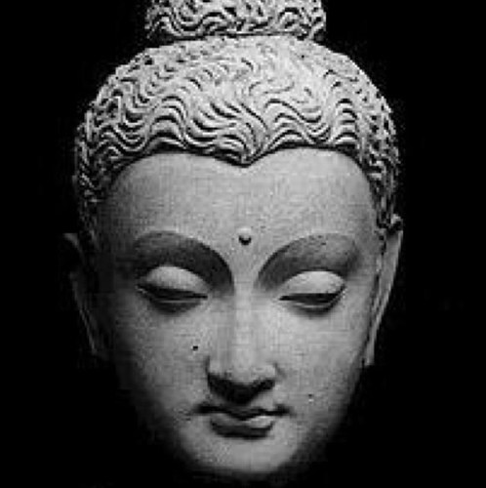
What else happened in 586?
Franks and Saxons inhabited the Germanic region
Limited democracy in Athens, Greece; 1st great western philosopher, Anaximenes, declared water the basis of all matter; and the great mathematician Pythagoras preached about the “transmigration of souls.”
35-yr old Nepalese aristocrat Siddhartha Gautama founds Buddhism (top right picture)
Confucius is active in China (bottom photo).

Slide 12
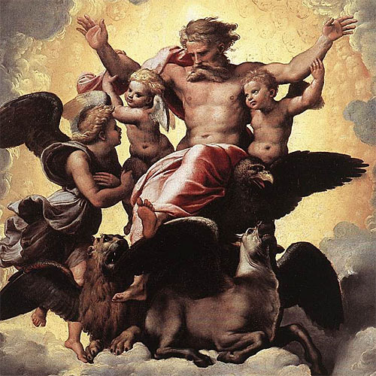
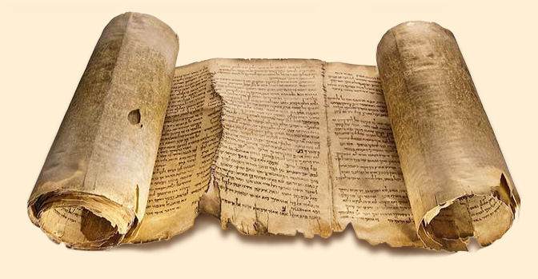
Why was 586 important? Literacy
The exile and the post-exile Persian and Greek (or “Second Temple”) period was when the core of the bible (the Torah) and some history books were written in final form. They were completed by around 530 or a bit after.
Many of the Prophecies and Writings also were inspired by these events. The exile author Ezekiel was one of the first to write his own story down, and Lamentations, which mourns the Babylonian invasion, was set down soon after composition.
Before 649-530, the temple had archives, records, collections of sayings, but most stories in the bible we know now were oral legends and folktales existing in several different versions.

Slide 13
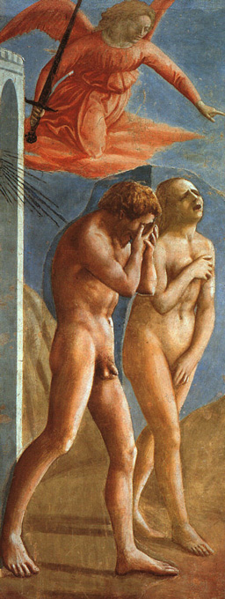
586: The Impact of Exile
When the Jerusalem Temple was destroyed, most records were lost too. In exile, priests and scribes reconstructed old stories, invented others, and saw the importance of having a permanent collection. But the canon had many more books than the Hebrew bible has today, and was not finally closed until first century CE.
Because most texts were composed or finished post-exile, they reflect post-exile concerns: a sense of homelessness, a covenant that is permanently postponed, and an identity defined by exclusion, separation, and ethnic and cultural purity.
This is a picture of Adam and Eve expelled from Eden (Masaccio). This expulsion became one metaphor for post-exile life.

Slide 14
What are some post-exile themes?
The meaning of homeland, homelessness and exile (including stories or episodes in Genesis, Exodus, and Deuteronomy that end outside the promised land)
The idea of boundary crossing or liminal space—being a stranger (“hapiru” or Hebrew) in a foreign land, living in two worlds or classes, or living on the boundaries of a society
God’s promises to the patriarchs, and God’s deferment and delay in fulfilling them (as evidenced by the way the Hebrew bible ends, with the temple forever about to be rebuilt)
The relationship between Israel and the rest of the world (“the nations”)—separation or assimilation?
Despite the bible’s aniconism, the “physical nature” of Yahweh/El and the way Yahweh/El appears to human beings
The role of women of valor (Eishes Chayil): family, and community in the survival of the post-exile vassal kingdom
The question of who should have access to information about God—chosen patriarchs; kings (David, Saul, Solomon); Prophets (Samuel, Moses, Deborah, Elijah, Miriam, Nathan); Priests (Aaron, Priestly writer); the community at large (Ezra/Nehemiah), or individuals through prayer or vision (apocryphal writings of Esther and Tobit plus apocalyptic writings like Daniel)
The reason for and nature of suffering, including the exile itself

Slide 15
Terms to know
Torah
What Christians call The Pentateuch, The Torah means Law or Instruction. It is the first five books of bible, and it may contain elements by many authors. But the post-exile writers who reconstructed it filled it with post-exile concerns: a sense of homelessness, a covenant that is permanently postponed, & an identity defined by exclusion, separation, and ethnic and cultural purity.
Tanak
Another name for what Christians called the Old Testament and what we’ll call the Hebrew Bible is Tanak or TNK. That is shorthand for the three parts of the Hebrew bible: Torah, Nevi’im (Prophets), and Ketuvim (Writings). The Prophets wrote in response to crises, especially the Assyrian and Babylonian invasions.
The writings
Like other parts of the Hebrew bible, the Writings (Ketuvim) were written as responses to problems of post-exile existence. They sometimes echoed but often challenged the dominant biblical interpretations of events. Because they were written last, the Hebrew canon places them last in order.

Slide 16
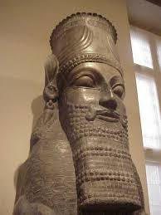
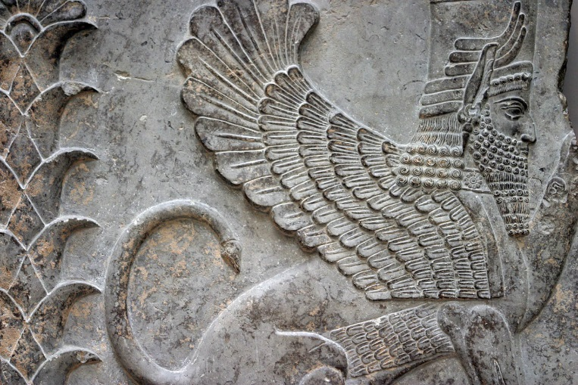
586: Impact of other cultures
During the Babylonian, Persian, and Hellenistic (Greek) periods that followed, rural Israel (also called Palestine after Greek invaders that once lived there) joined a large, vibrant empire. The bible’s writers were influenced by religious and literary traditions from Egypt, Persia (Iran), Babylon (Iraq), Greece, Assyria, Ethiopia, and parts of India.
They borrowed keys concepts (Devil, heaven/hell, guardian angels, demons) from Persia, and their creation, flood, and law stories could have been influenced by other cultures as well.

Slide 17
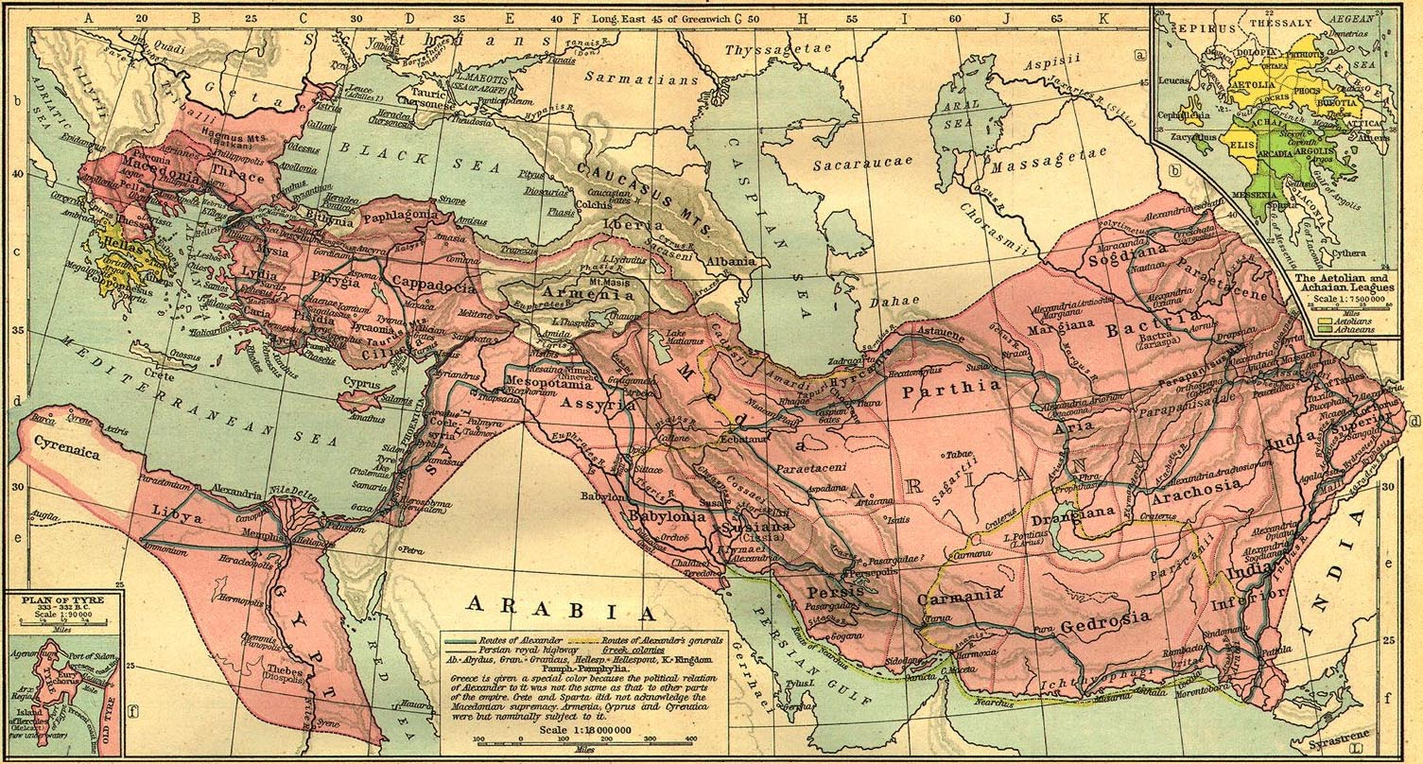
Alexander’s Empire (map)
Alexander’s empire encompassed Europe from Italy to Greece, the middle East, Asia to India, and northern Africa. This empire “Hellenized” (spread the influence of Greek culture through) the entire region. Late second temple Israel came into contact with a host of other cultures.

Slide 18
What 586 means for us
We’ll be concentrating mainly on the Hebrew Bible or Old Testament.
The Hebrew Bible was composed as a response to military defeat and colonial rule in the midst of a wide range of very divergent religious ideas and cultural traditions including Buddhism, Confucianism, Greek polytheism, Zoroastrianism, reincarnation, and dualism.
Its individual parts were mostly composed outside of Israel during exile AND in response to post-exile issues.
It found its final form during the time of the early Jesus movement, after the second temple was destroyed by the Romans.
Even its creation stories reflect nostalgia, a sense of homelessness, and separatism, as its authors tried to define their existence among foreigners and strangers.

Slide 19
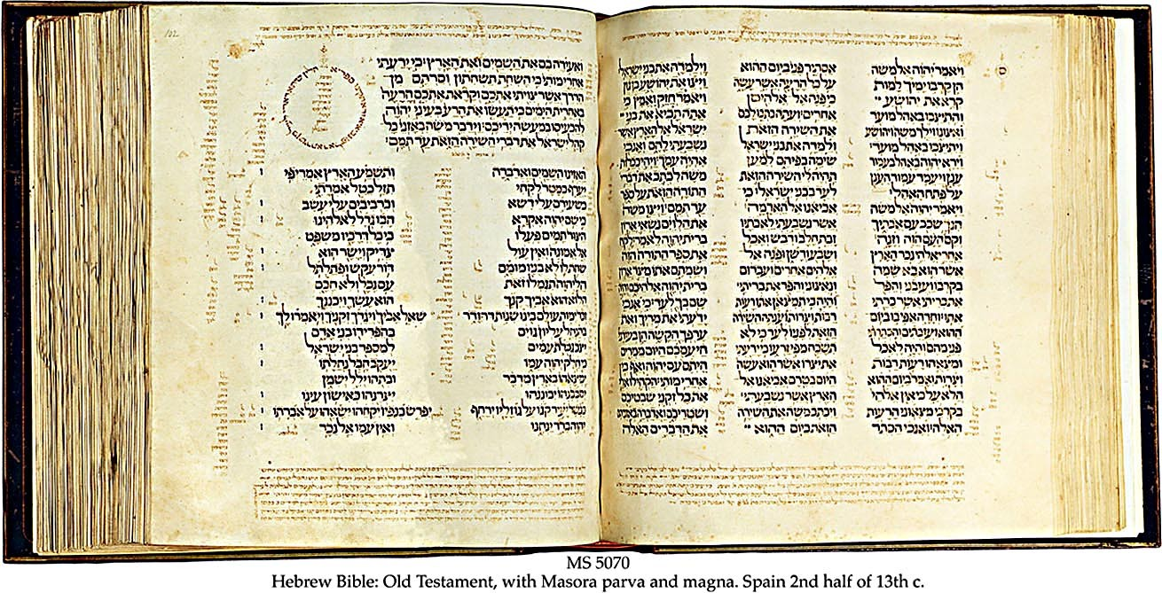
Part 2: What is the bible?
An illustration of a 13th century Hebrew Bible.

Slide 20
What is the bible, anyway?
Bible is a Greek word meaning “little books.” No single bible exists, because the canon of each group is different. Our bible has three main parts:
The Hebrew bible, written mostly in Hebrew
The Apocrypha, written mostly in Greek
The New Testament, written mostly in “koine” Greek, which was the common language of merchants and traders in the Roman Empire.

Slide 21
Terms to know
BCE
Instead of BC (Before Christ), we now say BCE (Before the common era). That’s because many religions are based on the bible, and only Christian religions accept Jesus as literally the Christ (Messiah) or son of God. (Christ is a Greek translation of the Hebrew word Messiah, which meant “son of a god” or king.) BCE refers to the period up to 0.
CE
Common Era, or CE, replaces the Latin Anno Domine or Year of our Lord (AD) for the same reason. CE refers to events after 0.
First Temple and
Second Temple
Periods
Most biblical books reached their final shape either in exile or afterwards—what’s known as the Second Temple Period, which ends when the second temple was destroyed by the Romans in 70 CE. But these books are often “set” in the First Temple Period, which dates from the time of David and Solomon (who may have been mythical kings) up to 586 BCE.

Slide 22
More Terms to know
Canon
Jews, Catholics, Greek Orthodox, Protestants, and Muslims all consider different books of the bible “canonical” or essential, but not one of these groups uses the same order. Many books considered essential in Jesus’s time are not in our canon any more, so we don’t have access to the “canon” of early Christians or first-century Jews who assembled the “Tanak” or Old Testament. The canon of the Tanak was fixed by the end of the first or second century. The Catholic canon was fixed in the 4th century. The protestant reformation fixed the Protestant canon in the 15th century.
Book
The closest thing to our modern books was a Roman codex. Most of the parts of the Hebrew bible were written on one or more scrolls. But a book was never really finished. When scholars copied a scroll, they often “updated it” to make sense in terms of present events. That’s why dating books in the bible is so difficult.
Pseudo-
nymous
Writing in the voice of a famous person (pseudonymously) was a common way to gain authority, and it was accepted practice in the ancient near East. Many biblical books (Deuteronomy, Daniel, Enoch) were attributed to ancient writers but written much later, anonymously. The four New Testament gospels were anonymous, but were attributed to Jesus’s apostles long after they were written.

Slide 23
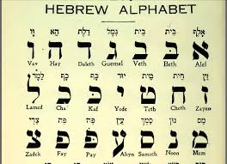
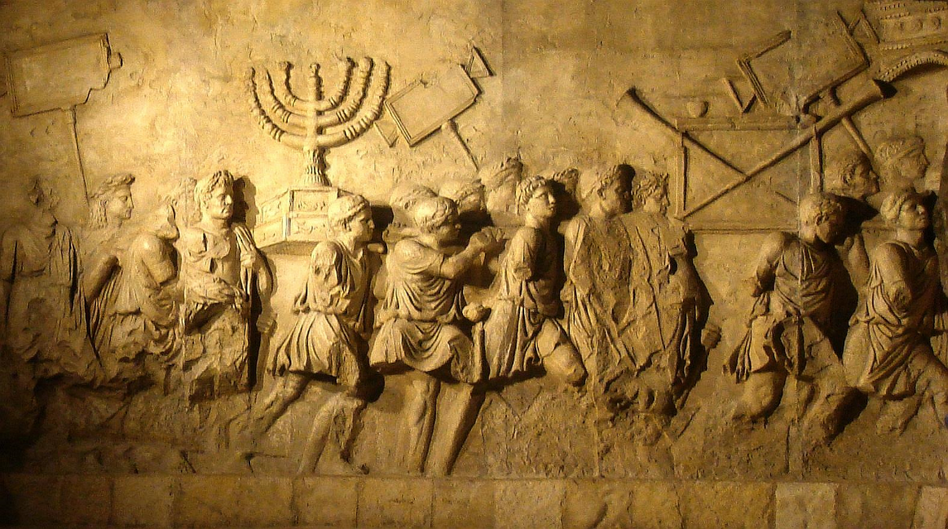
The Hebrew Bible?
The Hebrew Bible is similar to what Christians call the Old Testament, but in different order.
It is written mostly in Hebrew but also in Aramaic (the common language of the Persian empire).
Our bible (Oxford New Revised Standard version) uses the Christian order of texts, but we’ll often discuss the books in terms of the Jewish order.
The newest book accepted in the Hebrew bible was Daniel. It was accepted because it was set in the sixth century during the time of exile (but actually written around 165 BCE).

Slide 24
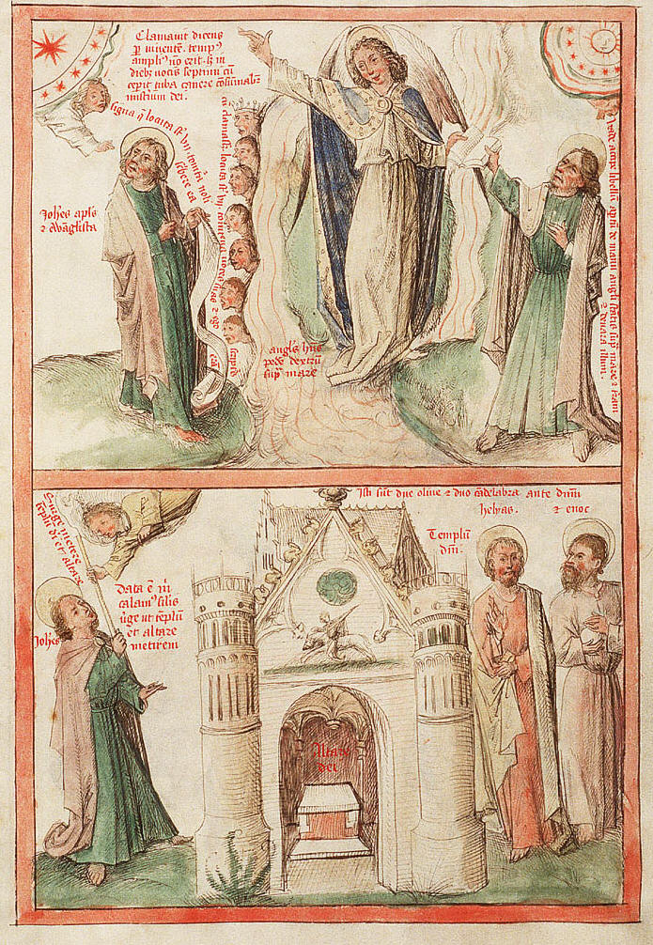
The Apocrypha and Pseudepigrapha
The Apocrypha is a collection of later Jewish books, written mostly in Greek. These were known by first century Common Era (CE) Jews like Jesus, Paul, and the authors of the gospels, but were excluded from the final Jewish canon as being too new. Most are “pseudonymous,” meaning they are attributed to famous people but not written by them. They are in the Catholic and Greek canons, but not the Protestant canon.
A huge number of texts did not make into any canon. These are sometimes called the Pseudepigrapha. Some, like the Magic of Solomon and the Book of Enoch, had a strong impact on the Catholic church and Christian notions of hell, Satan, original sin, and purgatory.

Slide 25
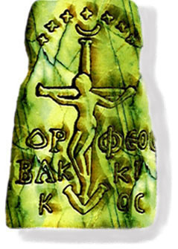
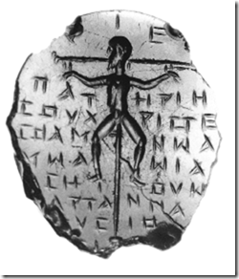
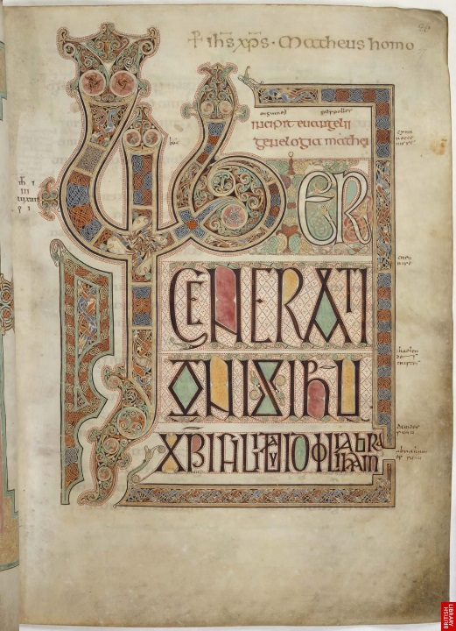
The New Testament?
The New Testament was written in Greek in the Roman Empire, mostly by Jews, mostly after the destruction of Jerusalem’s second temple in 70 CE. Its main character, Jesus (Greek for Yeshuah), existed in many versions that synthesized many pagan spiritual traditions and practices: Rabbinical Judaism; Greek philosophy; Roman mystery rites that practiced ritual cannibalism and believed in purification by death, resurrection, and baptism; Persian Zoroastrianism; and perhaps Buddhism and Confucianism.
The final Catholic canon, fixed around the fourth century CE, also excluded many books and traditions about Jesus.

Slide 26
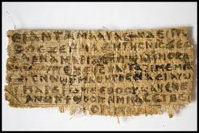
What was excluded from the New Testament?
Some excluded books were called Gnostic gospels, only recently rediscovered. The Gnostics thought they had secret knowledge of God. These gospels were excluded because were anti-Old Testament (Hebrew Bible) and did not believe in the salvation of the body. They were also quite radical and didn’t fit in with Empire politics. The Gospel of Judas, for example, taught that Judas was a hero for freeing Jesus from his body.
Other excluded gospels had little authority or told disturbing tales. For example, the Infancy Gospel of Thomas told of the cruel and dangerous pranks Jesus pulled as a child, including killing other schoolchildren and made those who tattled on him blind. The Infancy Gospel of James is the source for the idea that Mary’s mother Anna immaculately conceived her. Some were letters falsely attributed to Paul, Peter, or other early apostles.

Slide 27
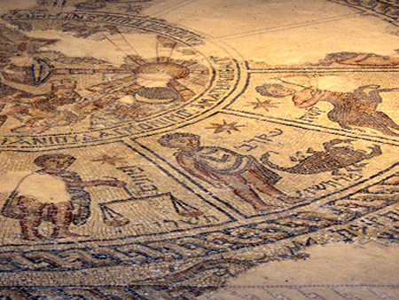
Who was Jesus?
Jesus (or Yeshuah) was a Jew. He probably lived in Galilee but worked with his father in a Roman business center called Sepphoris. He could read, perhaps, but probably not write.
The first “Christians” were his disciples, led by his brother James and a friend named Peter. Peter and James probably couldn’t write. Paul, a highly educated Pharisee, created a variant version of this “Jesus movement,” and his version caught on.
Paul is arguably the “real” author of some aspects of Christianity. Paul was a widely read, creative Jewish scholar whose version of Jesus wasn’t dependent on the man or his teachings.
Both Jesus and Paul believed the end times were immanent.
Above: a zodiac wheel in a Jewish synagogue in Sepphoris.
No Christian existed before 36 CE, so the audience for the Hebrew Bible contained no Christians.

Slide 28
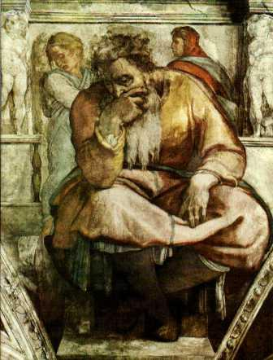
How did the bible get English? Latin first
The bible was translated into Latin by Jeremiah. For centuries, it was the only version of the bible available, and it was a crime to translate it, so most Europeans knew the bible only through paintings and street plays.
It was a good translation, but it made many errors. For example, the character Lucifer is a Latin mis-translation of “sons of light,” or Babylonians. Though the King James Bible retains this error and others like it, no character Lucifer is actually mentioned in the Bible.

Slide 29
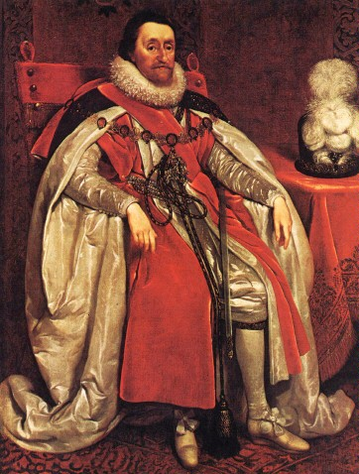
What’s the King James Bible?
In the 14th and 15th centuries, people suffered great persecution to translate the bible into their spoken languages.
The King James bible was a translation authorized by the King of England in 1611. It followed other great translations such as the Wycliffe bible, the Coverdale bible, and the Geneva bible, which the King thought too radical.
The Geneva bible and the King James bible used went back to the original Greek and Hebrew sources, so they were good, but their translators knew less about biblical Hebrew than we know today.

Slide 30
Why are we using this translation?
Currency: the King James bible was written in Shakespeare’s time by poets. It was beautiful, but hard for ordinary people to understand, then as now, and not that accurate.
Accuracy: this translation not only reflects the latest scholarship about Hebrew and biblical studies, but it incorporates some variations used by different versions of these texts, versions discovered in the 1940’s among the Dead Sea Scrolls in Qumran.

Slide 31
Why this translation– continued…
Principles of translation: because ancient Hebrew is so different from English, translators choose either Dynamic equivalence (expresses the main idea, sometimes to the point of reinterpretation), formal equivalence (expresses the literal meaning, even if it doesn’t make sense), or a balance between the two.
The New Revised Standard Version uses an excellent balance, and our version provides footnotes whenever an alternate literal reading is possible. Because this “balanced” translation isn’t associated with a denomination or sect, it is more trustworthy than some others.

Slide 32
Three approaches: examples
Formal Equivalence | Balanced Approach | Extensive Dynamic Equivalence
American Standard Version of 1901 New American Standard Bible King James Version (formal equivalence, albeit to 17th-century English) New King James Version English Standard Version Revised Standard Version Douay-Rheims American Version Green's Literal Translation | Holman Christian Standard Bible called "optimal" equivalence New Revised Standard Version New American Bible New English Translation Murdock's Translation Modern Language Bible | New International Version Today's New International Version[5] New Jerusalem Bible Revised English Bible Good News Bible (formerly "Today's English Version") Complete Jewish Bible New Living Translation The Living Bible Phillips Modern English The Message

Slide 33
What difference does the translation make? The Case of Leviticus
This passage from Leviticus 18:22 is used by many fundamentalist Christians and Jews to justify discrimination against same sex behavior:
“You shall not lie with a male as with a woman; it is an abomination.” (NRSV)

Slide 34
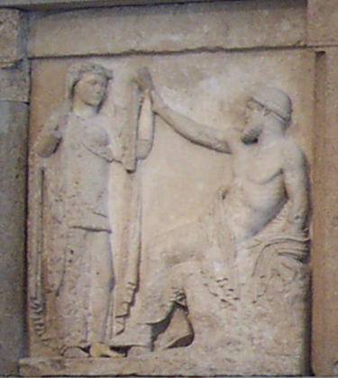
Temple Prostitution and the “Sacred Marriage”: The Context
Many ancient cultures had a sacred temple practice called heiros gamos or sacred marriage, and because the bible refers to temple prostitutes, some think heiros gamos was part of ancient temple ritual.
Leviticus deals with proper temple worship and prohibits fertility worship practices found in early Pagan cultures; ritual same-sex behavior in Pagan temples was one such practice, so some think this passage refers only to “temple sex.”
So how does one translate this passage? These translations show a wide variation, depending on how you read the surrounding passages.
An illustration of pagan “sacred marriage” from a Greek Temple frieze.

Slide 35
Leviticus 18:22 – some translations
RSV: You shall not lie with a male as with a woman; it is an abomination (male to male only?)
NLT: (New Living Translation): "Do not practice homosexuality; it is a detestable sin." (all same sex? “homosexual” coined in the 19th c.)
New International Reader’s Version: “'Do not have sex with a man as you would have sex with a woman. I hate that.”
These translations differ not only in their reading of “lie with” but in their interpretation of “Towebah” or abomination.

Slide 36
Why read “in context”
Many of us learn the bible a verse at a time, and someone tells us what the verse means.
However, a passage may mean something very different “in context”—that is, if you read the work as a whole.
Sometimes, too, it helps to know why the author was writing the work—who his audience was, what the occasion was, what his ultimate goal was.

Slide 37
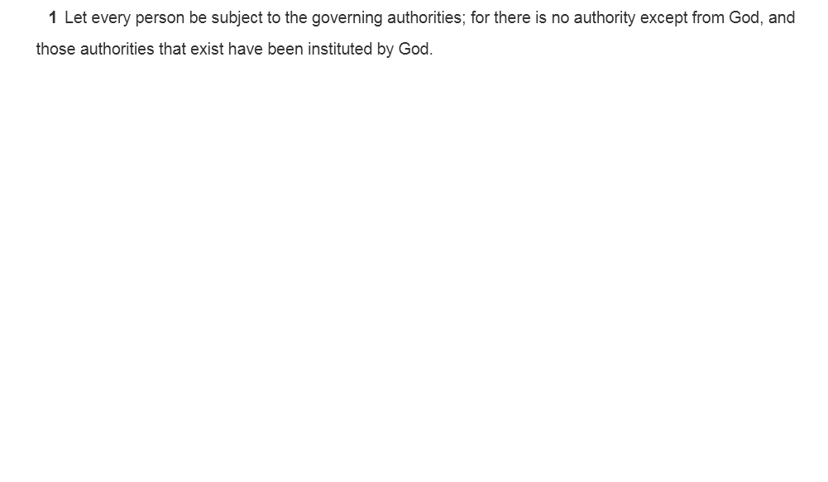
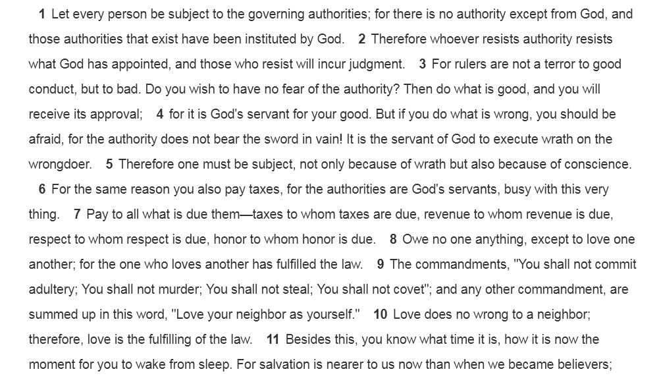
Example: Sessions quotes Romans 13

Slide 38
American context

Slide 39
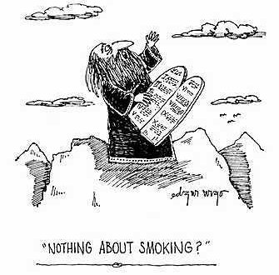
Is the bible “inerrant”?
Is the Bible “inerrant” (that is, did God write it and, if so, did He write or cause to be written all of the translations?) many Christians believe so.
How do we reconcile what we know about the biblical transmission (copying, preserving, handing down) with this idea?

Slide 40
No Bible has the “Last Word”
Not only do many canons exist, but we now know each text existed in multiple versions
Our oldest Old Testament (Hebrew Bible) texts post-date the events they record by 1,000 years.
The Hebrew Bible was transmitted orally, then copied, changed, edited, harmonized, and recopied. Exile communities possessed variants. Do the variants matter? Should we consider textual variants when striving to understand the bible?
The New Testament gospels were written after Jesus died; not only don’t the gospels themselves agree, but variant texts and gospels existed all over the empire. We don’t have a copy of any New Testament gospel older than the fourth century CE.
Translation shapes how we read texts. Do all translations hold equal value? Are all approaches to translation equally valid?

Slide 41
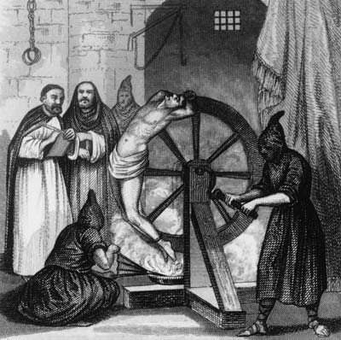
What these issues mean for our class
In this class, we’ll examine what difference a translation makes in our reading.
We’ll learn about the four or more Torah authors, and we’ll speculate about how their different concerns shaped the bible
We’ll relate Hebrew bible stories to the forces of conquest and colonial rule that shaped them, rather than reading them as Christian spiritual and ethical documents.
This 1500 depiction of the Spanish Inquisition shows what can happen when we disagree about the bible.

Slide 42
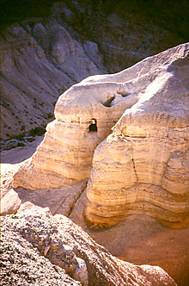
What does it mean (continued)
We’ll be thinking about why some stories were included and not others. We’ll look at the works left out of the bible.
We’ll look at select New Testament works as authored (mostly) by Jews committed to continuing, not abandoning, the Hebrew biblical themes.
We’ll think of the bible as a whole as an anthology of dissenting voices, not a harmonized and planned work centered around Jesus.
Some thing Jesus and John the Baptist belonged to the Essene community in Qumran, the fringe Jewish group that produced the Dead Sea Scrolls

Slide 43
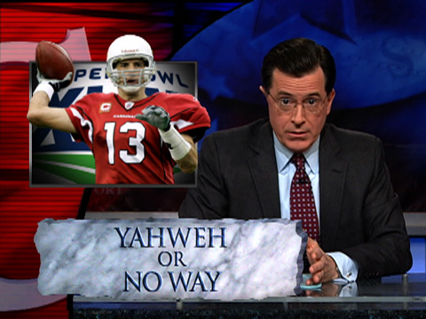
Finally…
We must respect each other’s differences. While it is okay to refer to our own background and religious education by way of comparison, insisting on one right way of thinking or deriding others is not okay.
The ideas we’re discussing in this class are accepted by many scholars, but not all. You are responsible for knowing about them, even if you choose not to accept them.

