Slide 1
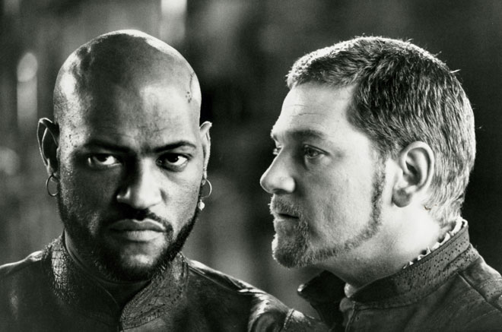
Othello Adaptations
Lesley Plowman, Jalen Brown, Emily Teague & Sandra Nikula
Notes:
Image From: http://www.google.com/imgres?imgurl=http%3A%2F%2Fmedia.jrn.com%2Fimages%2Fiago_bigstory.jpg&imgrefurl=http%3A%2F%2Fwww.jsonline.com%2Fentertainment%2Farts%2Fsnodin-fails-to-bring-iago-to-life-8n3h5hd-136442388.html&h=437&w=660&tbnid=jywl11XIKy7VHM%3A&zoom=1&docid=e9_fy7oTYWN-ZM&ei=0_lWU8LNKabh2AWv2oGwCw&tbm=isch&ved=0CIgBEDMoHDAc&iact=rc&uact=3&dur=854&page=2&start=11&ndsp=25

Slide 2
I,Iago Nicole Galland
“Before”
“After”
Making a Villain a Hero
What is the “truth”?
Answering “Why?”
Notes:
Image From: http://www.google.com/imgres?imgurl=http%3A%2F%2Fnicolegalland.com%2Fwp-content%2Fuploads%2F2012%2F02%2FI_Iago_Nicole_Galland_1280px-tall.jpg&imgrefurl=http%3A%2F%2Fnicolegalland.com%2Fbooks%2Fi-iago%2F&h=1280&w=851&tbnid=WWnJac9AHPBCsM%3A&zoom=1&docid=_y236nx0SvF_QM&ei=dPxWU8zzDI-_2QWy4ID4DA&tbm=isch&ved=0CFQQMygAMAA&iact=rc&uact=3&dur=459&page=1&start=0&ndsp=26

Slide 3
Omkara (2006)
Summary
Indu kills Langda
Setting (Meerut in Western Uttar Pradesh)
Politics
Notes:
Image From: http://www.google.com/imgres?imgurl=http%3A%2F%2Fwww.glamsham.com%2Fmovies%2Fscoops%2F06%2Fjul%2Fomkara1.jpg&imgrefurl=http%3A%2F%2Fwww.glamsham.com%2Fmovies%2Fscoops%2F06%2Fjul%2F21omkara.asp&h=282&w=470&tbnid=5tDMaRgIZ91UbM%3A&zoom=1&docid=U6gMjTps8quW4M&ei=M_tWU4vSNuOv2wX2i4CwAw&tbm=isch&ved=0CF4QMygKMAo&iact=rc&uact=3&dur=610&page=1&start=0&ndsp=17

Slide 4
Exposure Mal Peet
Summary
Celebrity Status and Media
Race
Desmerelda
The end of the novel
Notes:
Image From: http://www.google.com/imgres?imgurl=http%3A%2F%2Fwww.candlewick.com%2Fimages%2Fcwp_bookjackets%2F648%2F0763639419.jpg&imgrefurl=http%3A%2F%2Fwww.candlewick.com%2Fbookxtras.asp%3Fisbn%3D0763639419%26id%3D%26browse%3D%26view%3Djacket%26jacket%3D.%2Fimages%2Fcwp_bookjackets%2F648%2F0763639419.jpg%26bktitle%3DExposure&h=1000&w=643&tbnid=mrN5mfDRJ041tM%3A&zoom=1&docid=Ml0Ts1uLqsnRrM&ei=A_9WU5g97bjZBc2UgYgM&tbm=isch&ved=0CFIQMygAMAA&iact=rc&uact=3&dur=2582&page=1&start=0&ndsp=22

Slide 5
O (2001)
Summary
Setting
Age of Characters
Answers about Iago’s motivation
Powerful Ending
http://youtu.be/ht2cgNDWI4g
Notes:
Image From: http://www.google.com/imgres?imgurl=http%3A%2F%2Fwww.dvdsreleasedates.com%2Fposters%2F800%2FO%2FO-2001-movie-poster.jpg&imgrefurl=http%3A%2F%2Fwww.dvdsreleasedates.com%2Fmovies%2F1678%2FO-(2001).html&h=1200&w=800&tbnid=Il6pxkeKB-7K_M%3A&zoom=1&docid=vepkMS2n0UokNM&ei=OP1WU73lLaWS2QXIvICoAg&tbm=isch&ved=0CGkQMygCMAI&iact=rc&uact=3&dur=986&page=1&start=0&ndsp=15

Slide 6
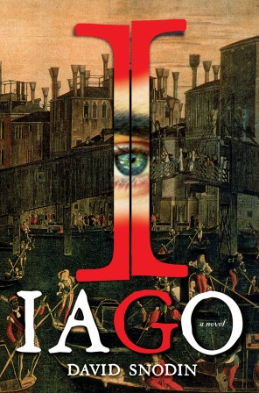
Iago David Snodin
Summary
After Othello
Cypriot Culture
Iago’s Violence, Jealousy, and Psychopathy
Notes:
Image From: http://www.google.com/imgres?imgurl=http%3A%2F%2Fwww.washingtonpost.com%2Frf%2Fimage_296w%2F2010-2019%2FWashingtonPost%2F2011%2F12%2F27%2FStyle%2FImages%2Fbooks1228charles.jpg&imgrefurl=http%3A%2F%2Fwww.washingtonpost.com%2Fentertainment%2Fbooks%2Fiago-by-david-snodin%2F2011%2F12%2F19%2FgIQA8r6BLP_story.html&h=448&w=296&tbnid=v-zSZEmOjSWoIM%3A&zoom=1&docid=_B33Q6uthUAksM&ei=NPlWU-zNG-Kb2wXTg4D4BQ&tbm=isch&ved=0CFIQMygAMAA&iact=rc&uact=3&dur=6275&page=1&start=0&ndsp=20

Slide 7
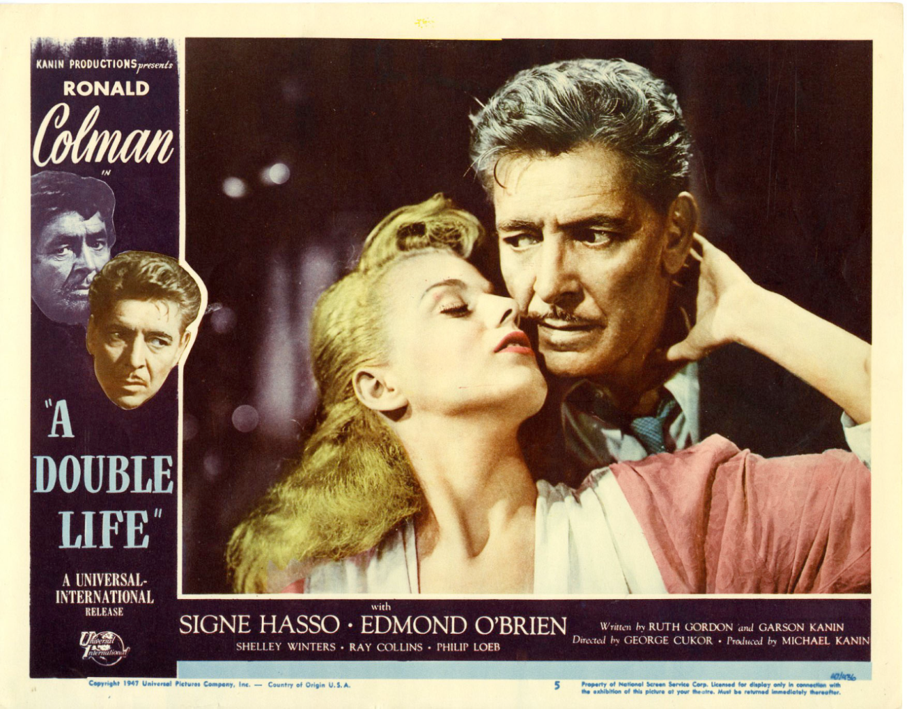
A Double Life (1947)
Summary
Mental Illness
Race Change
Brita (Desdemona)
Real and Stage Characters
Notes:
Image From: http://www.google.com/imgres?imgurl=http%3A%2F%2Fd1g4sq00ps2bp3.cloudfront.net%2Fentertainment%2F23602_5.jpg&imgrefurl=http%3A%2F%2Fwww.lewiswaynegallery.com%2Fa-double-life-1947-lobby-card-set-ronald-colman-p-2803.html&h=1374&w=1753&tbnid=GD8MqBLlZ9RgpM%3A&zoom=1&docid=AkYuVTR5_q_nxM&ei=bf9WU_i4OoXu2gWEmICwDQ&tbm=isch&ved=0CIIBEDMoKDAo&iact=rc&uact=3&dur=873&page=2&start=19&ndsp=24

Slide 8
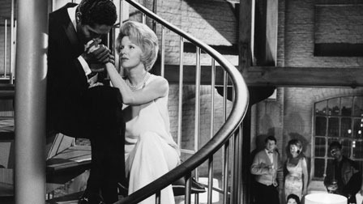
All Night Long (1962)
Summary
Important Characters
Celebrity Status
Happily Ever After
https://www.youtube.com/watch?v=KoqZK-UzlpU
Notes:
Image From: http://www.google.com/imgres?imgurl=http%3A%2F%2Fs3.amazonaws.com%2Fcriterion-production%2Fstills%2F130393-1a7d5375c4ae788e78401e2ddb38fc36%2FDeardon_Filmw_AllNightLong_original.jpg&imgrefurl=http%3A%2F%2Fwww.criterion.com%2Ffilms%2F27539-all-night-long&h=252&w=448&tbnid=gQl_O0gdSWH-TM%3A&zoom=1&docid=BYRti4YLKPDH9M&ei=S_hWU4aIEOei2wWhpIHQCA&tbm=isch&ved=0CFUQMygBMAE&iact=rc&uact=3&dur=935&page=1&start=0&ndsp=17

Slide 9
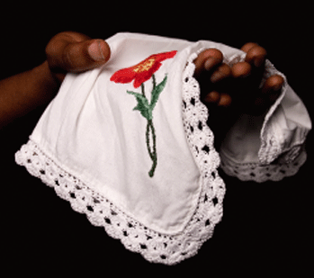
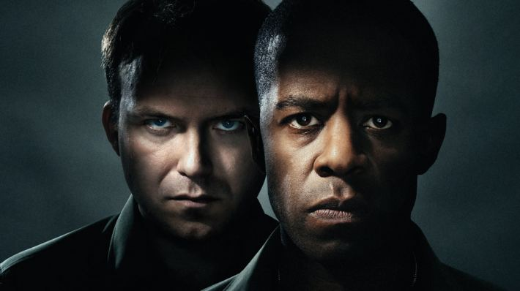
The Exotic
Truth &
Lies
Loyalty & Betrayal
Men VS Women
WAR
Race
Notes:
Image From: http://www.google.com/imgres?imgurl=http%3A%2F%2F1.bp.blogspot.com%2F-bdclmQIw8ZU%2FUNEcSmhwGmI%2FAAAAAAAAADU%2F-pOq8Gk2MEQ%2Fs1600%2Fothello-handkerchief-Betrayal.gif&imgrefurl=http%3A%2F%2Fblamegam.blogspot.com%2F&h=309&w=349&tbnid=A6VEi2yJ1xP9tM%3A&zoom=1&docid=Cz-5aoy4SHJ3nM&ei=-vlWU-baIeOT2QWmvYDwDA&tbm=isch&ved=0CFsQMyhTMFM4ZA&iact=rc&uact=3&dur=641&page=9&start=181&ndsp=26
Image From: http://www.google.com/imgres?imgurl=http%3A%2F%2Ftheshakespeareblog.com%2Fwp-content%2Fuploads%2F2013%2F04%2Fothello_poster.jpg&imgrefurl=http%3A%2F%2Ftheshakespeareblog.com%2F2013%2F04%2Fothello-iago-and-the-search-for-character%2F&h=398&w=710&tbnid=1PRQ2bmamRqlrM%3A&zoom=1&docid=DTOjlHxmcNGjEM&ei=0_lWU8LNKabh2AWv2oGwCw&tbm=isch&ved=0CI8BEDMoIzAj&iact=rc&uact=3&dur=536&page=2&start=11&ndsp=25

